Slide 1

WELCOME TO

Slide 2


About
ISUOG stands for International Society of Ultrasound in Obstetrics and Gynecology
ISUOG is a charitable organisation and the leading international society of experts in ultrasound for obstetrics and gynecology.
The Society includes Obstetricians and Gynecologists, trainees, medical doctors, scientists, sonographers, radiologists, midwives and other health professionals who work to advance women’s health and well-being globally.

Slide 3
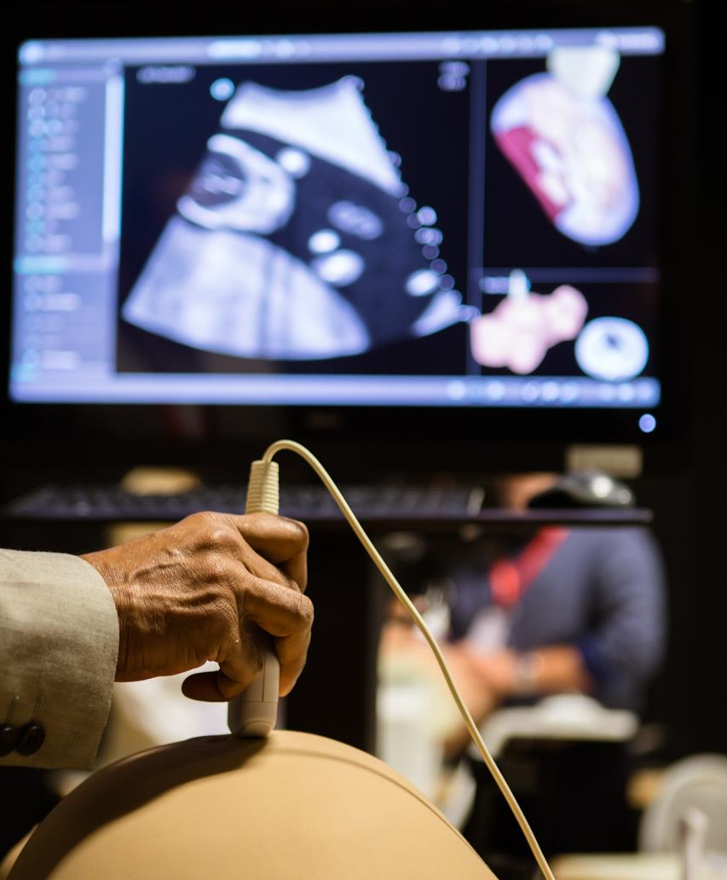

Our mission
Our mission is to improve women’s health through the provision, advancement and dissemination of the highest quality education, standards and research information around ultrasound in Obstetrics and Gynecology.
How?
We strive to achieve this through our education and training initiatives, our free access guidelines, advocacy though our events and social media platforms and by inspiring research though our publication and growing our reach.

Slide 4
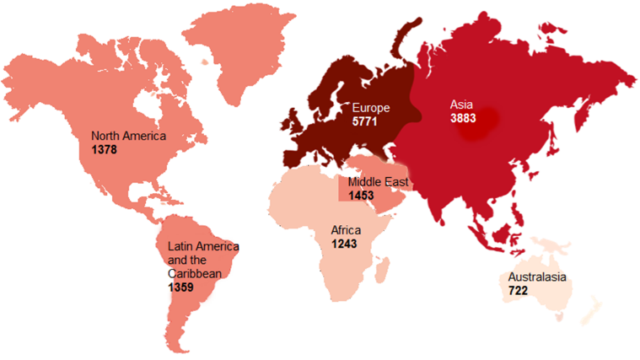
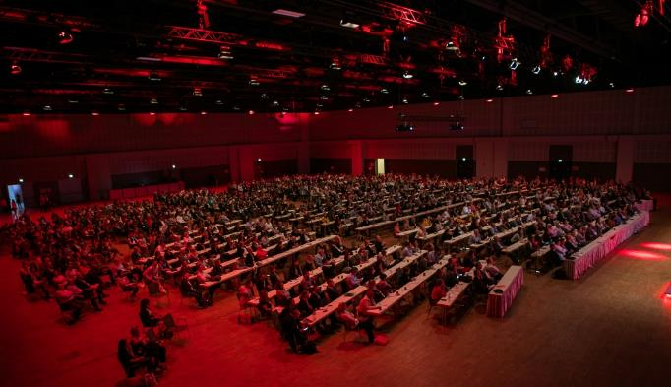
Our society is growing
We encourage members from all professions in the specialty, at all levels of training, internationally.
98% of our members would recommend membership to a colleague

Slide 5
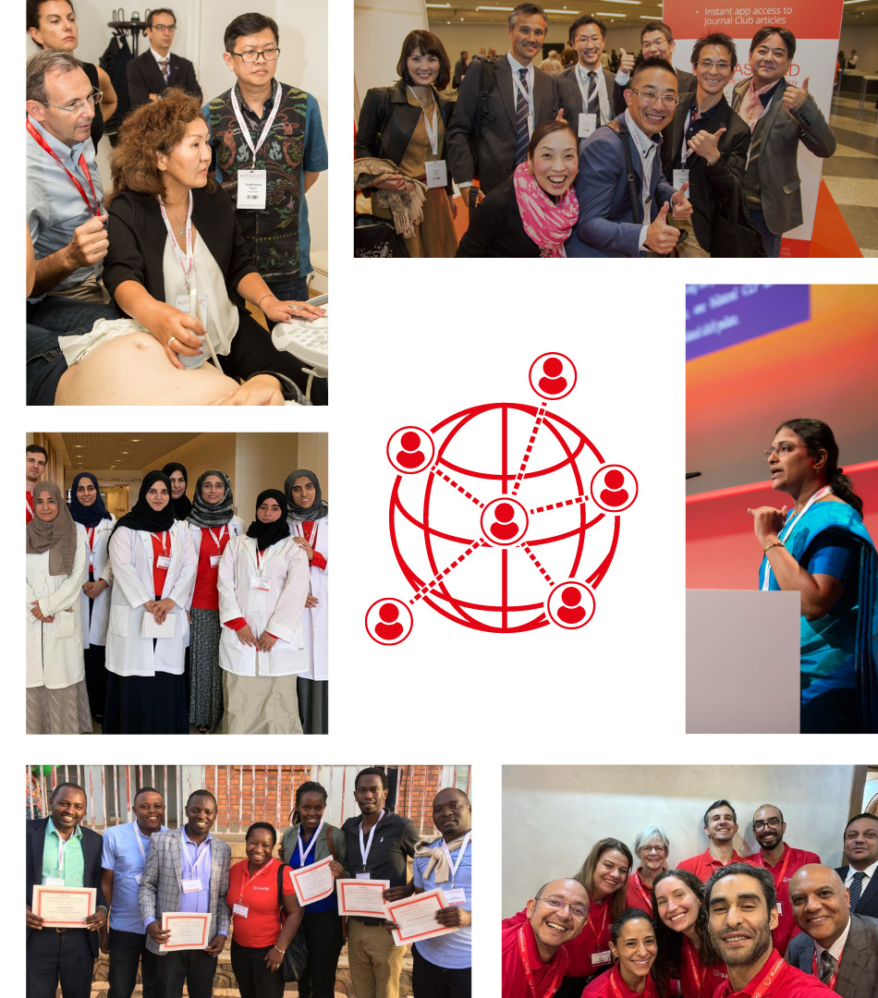

Membership
ISUOG membership provides you with access to a wealth of educational resources and experts in their field, but also to a global network of like-minded individuals with a shared passion and vision to improve women’s health.
Benefits include
Free CME Activities
Discounts to our events and courses
Access to VISUOG chapters
On-demand lectures
An online community forum to network
Join our
international
community

Slide 6







Trainee Membership
We offer free two-year membership through institutions. Ask your institution to email us on info@isuog.org
Benefits include
Online subscription to the UOG Journal.
Reduced fees to our education courses, World Congress and International Symposium events.
Access to over 1000 web resources.
And much more…

Slide 7



SAVE THE DATE
35th ISUOG World Congress on Ultrasound in Obstetrics and Gynecology
Cancún, Mexico​
14-17 September 2025
Key Dates:
Abstract submission opens: 11 October 2024
Abstract submission deadline: 18 March 2025
Early bird registration deadline: 14 July 2025
Pre-Congress courses: 13 September 2025

Slide 8
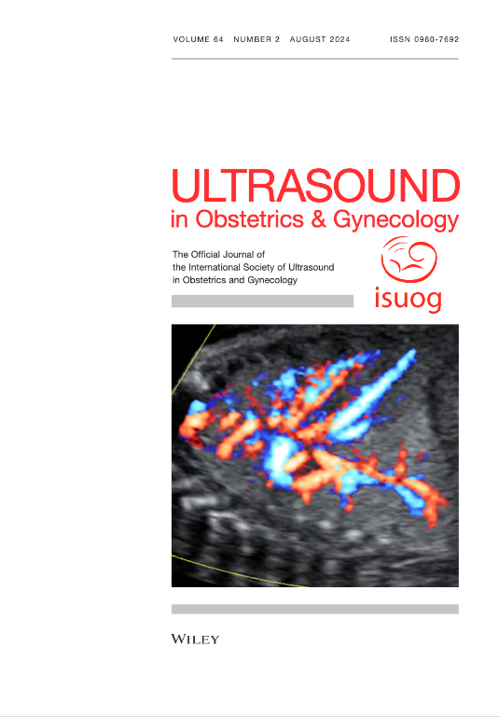



Research
leading peer-reviewed journal
Impact factor 6.1
6.2 million article downloads in 2023
Our Journal, Ultrasound in Obstetrics & Gynecology is the leading peer-reviewed journal on imaging within the field of obstetrics and gynecology.
The UOG journal includes monthly systematic reviews, referee commentaries and expert perspectives.
Have your work published in the UOG, the average Altmetric score was 106 for our top 10 articles in 2022

Slide 9
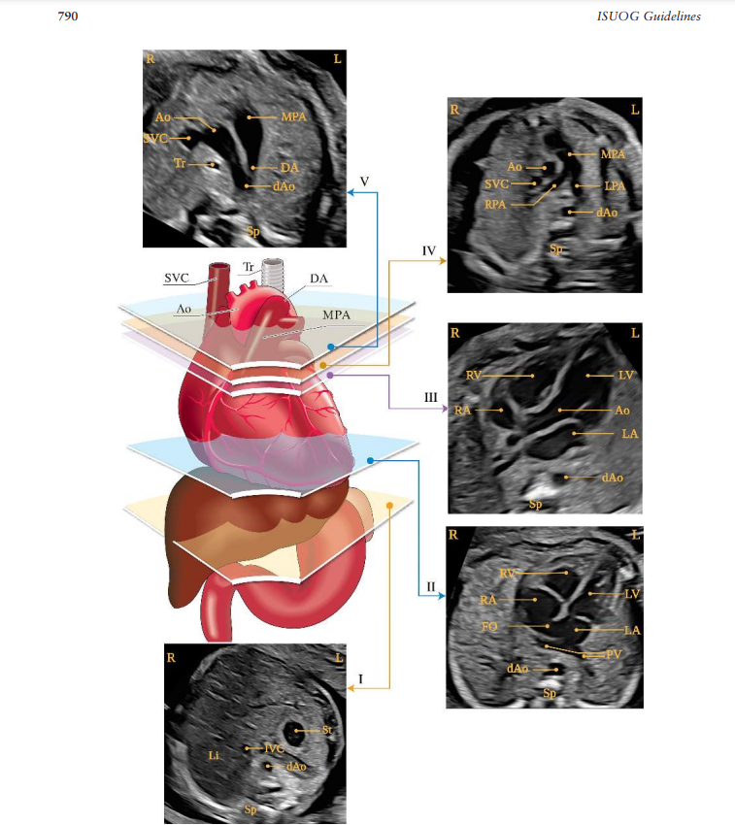
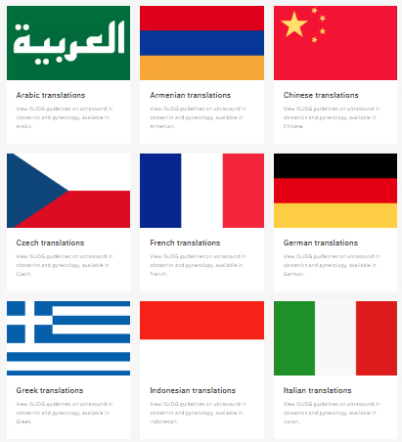
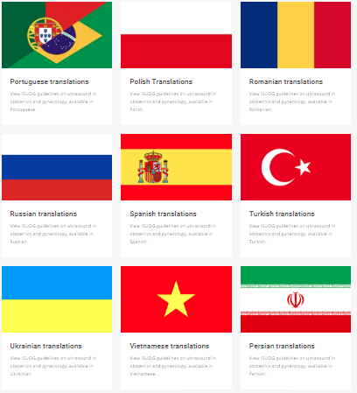
Practice Guidelines
The ISUOG Clinical Standards Committee (CSC) develops Practice Guidelines and Consensus Statements providing recommendations on how to improve and standardise medical care
15 Practice guidelines
11 Consensus statements
Translations in over 18 languages

Slide 10
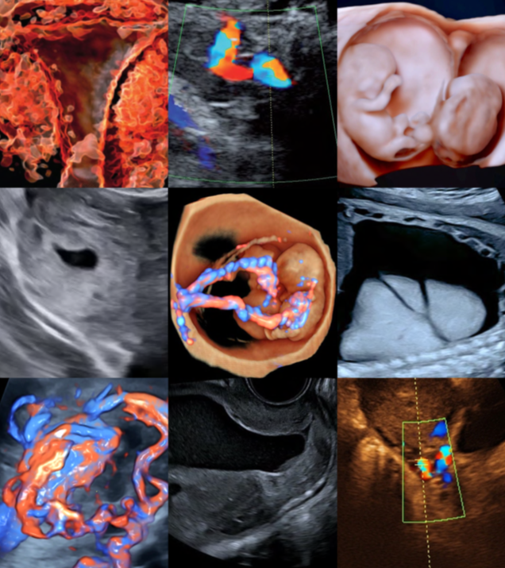

Education
ISUOG provides education for practitioners and trainees at all levels.
Enhance your skills and knowledge in ultrasound in obstetrics and gynecology through our lectures and courses delivered by leading names in the field.
Our educational courses deliver the latest developments and best practices, plus debates on key topics affecting obstetrics and gynecology practitioners across the globe.
Visit www.isuog.org/education

Slide 11


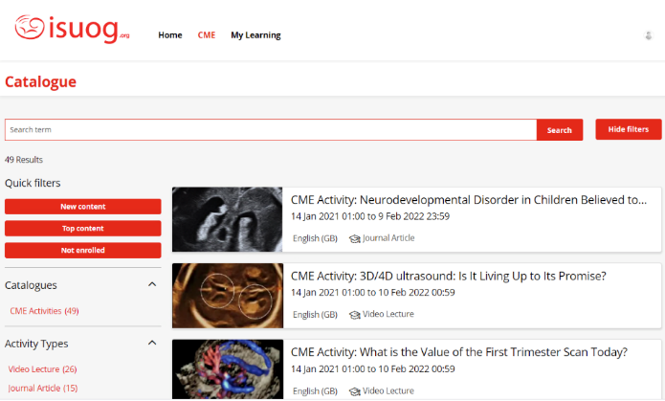
Online CME Platform
Our CME platform, ISUOG Academy has over 100 activities so far. The platform offers a mixture of learning tools such as videos, guidelines articles and lectures.
Activities include:
Practice Guidelines
Journal articles
Video lectures
Features include:
Responsive user experience
Structured learning
On the spot certification
Earn CME credit anytime, anywhere. The process is simple!

Slide 12

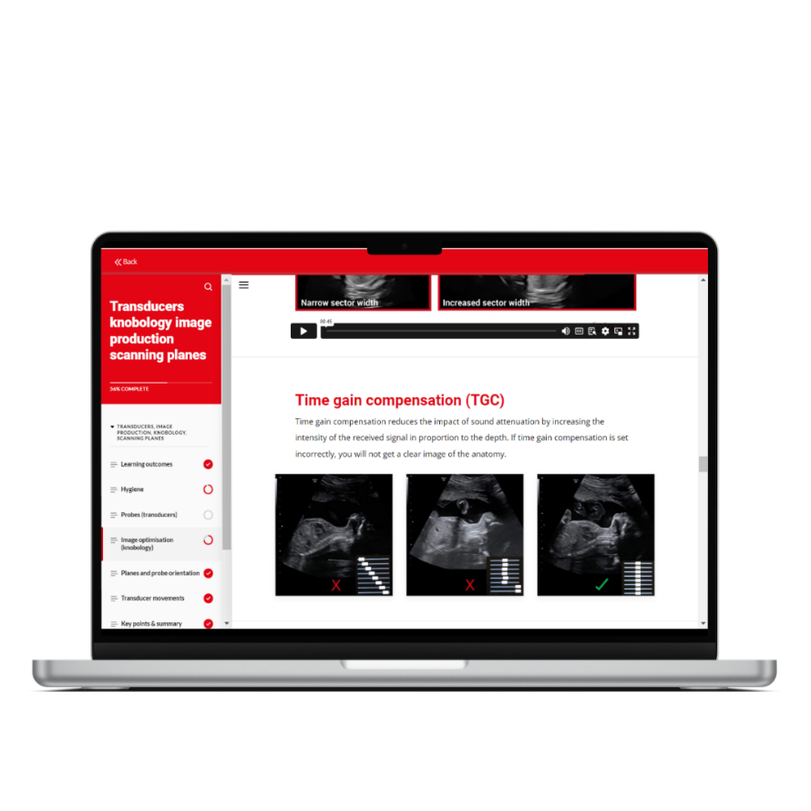
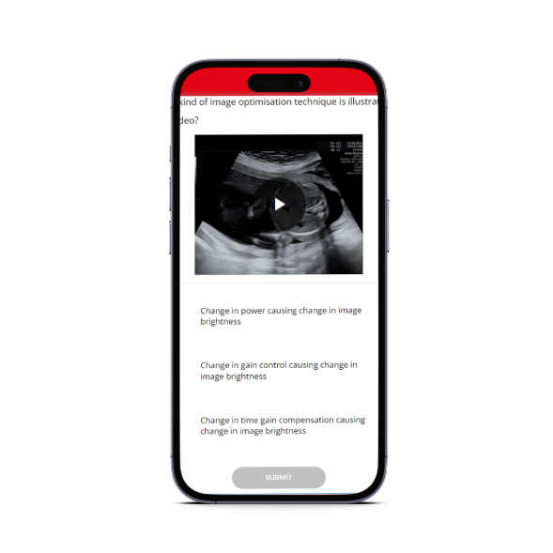
Basic Training Online Program
Foundational program of ultrasound in obstetrics and gynecology!
12 months’ access
30 interactive courses
Test your knowledge as you learn
ISUOG Certificate
EACCME Certificate for 30 CME credits
New and updated images and videos
Live demonstration videos and simulations
Illustrations, research data, supplementary reading, and more.
Visit www.isuog.org/education/basic-training for more details and pricing

Slide 13
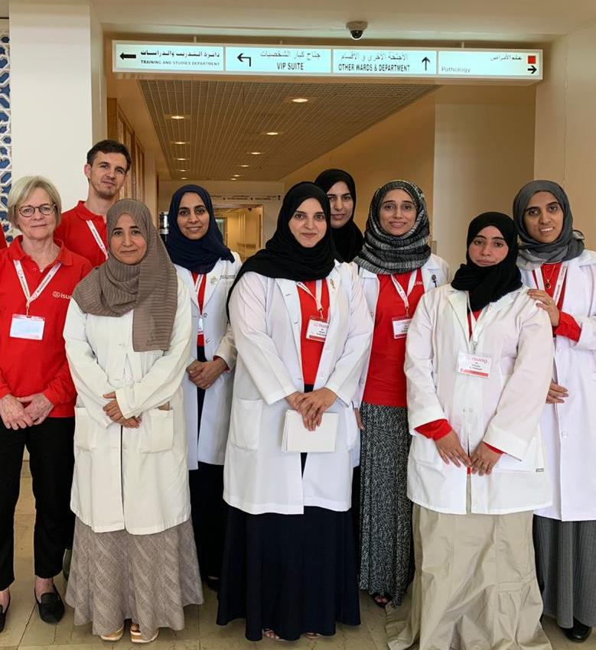
Outreach
ISUOG Outreach Vision: Every woman should undergo a safe and patient-centred quality ultrasound as part of their healthcare evaluation.
How?
ISUOG Outreach builds a sustainable national health structure for providing OBGYN Ultrasound to all women in a specific underserved country. Outreach helps a country to provide quality and accessible care to all its women through training their trainers to raising the level of their skills and knowledge. ISUOG Outreach also works with their Governments to ensure sustainability through post-program support.

Slide 14
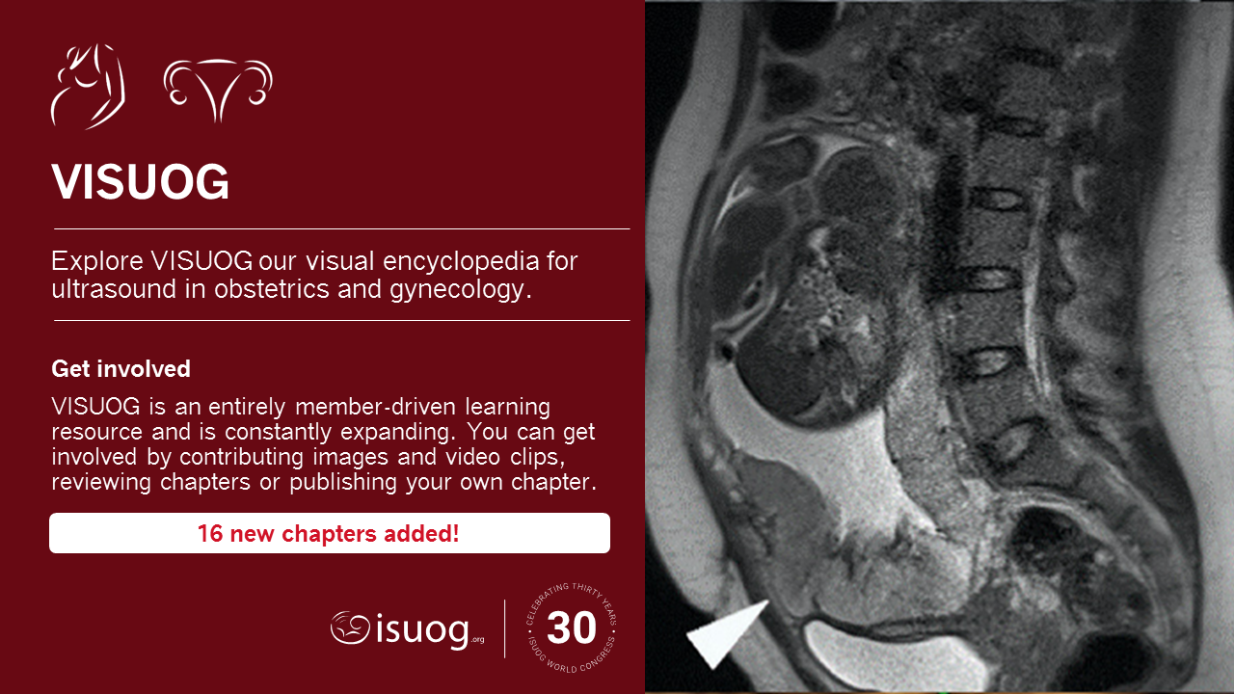

https://www.isuog.org/education/visuog.html

Slide 15
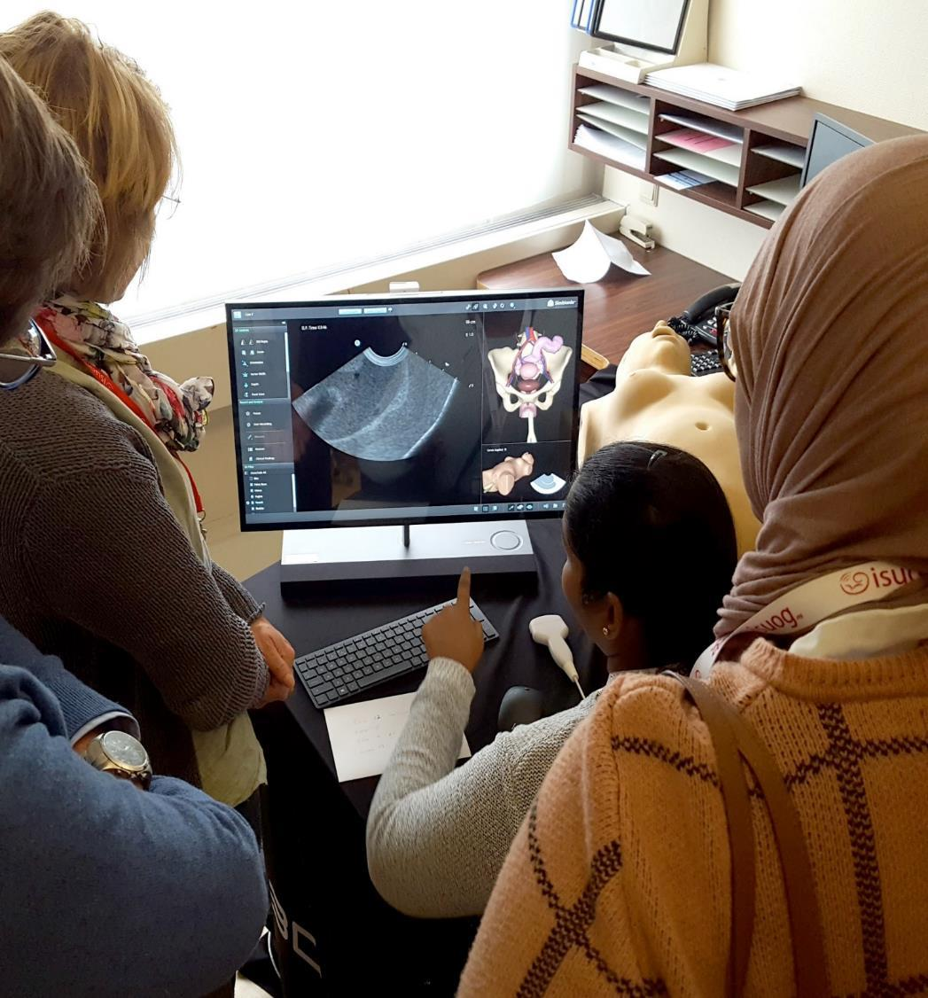
Run a BT
ISUOG now offers universities and training institutions the opportunity to run an ISUOG Basic Training program. ISUOG provides educational resources and administrative support at no cost.
Delivered by your own faculty in your own time
Resources and administrative support provided
Flexible and cost-efficient
Certification of completion can be obtained
Get in touch! Apply to run an ISUOG Basic Training Course today.

Slide 16
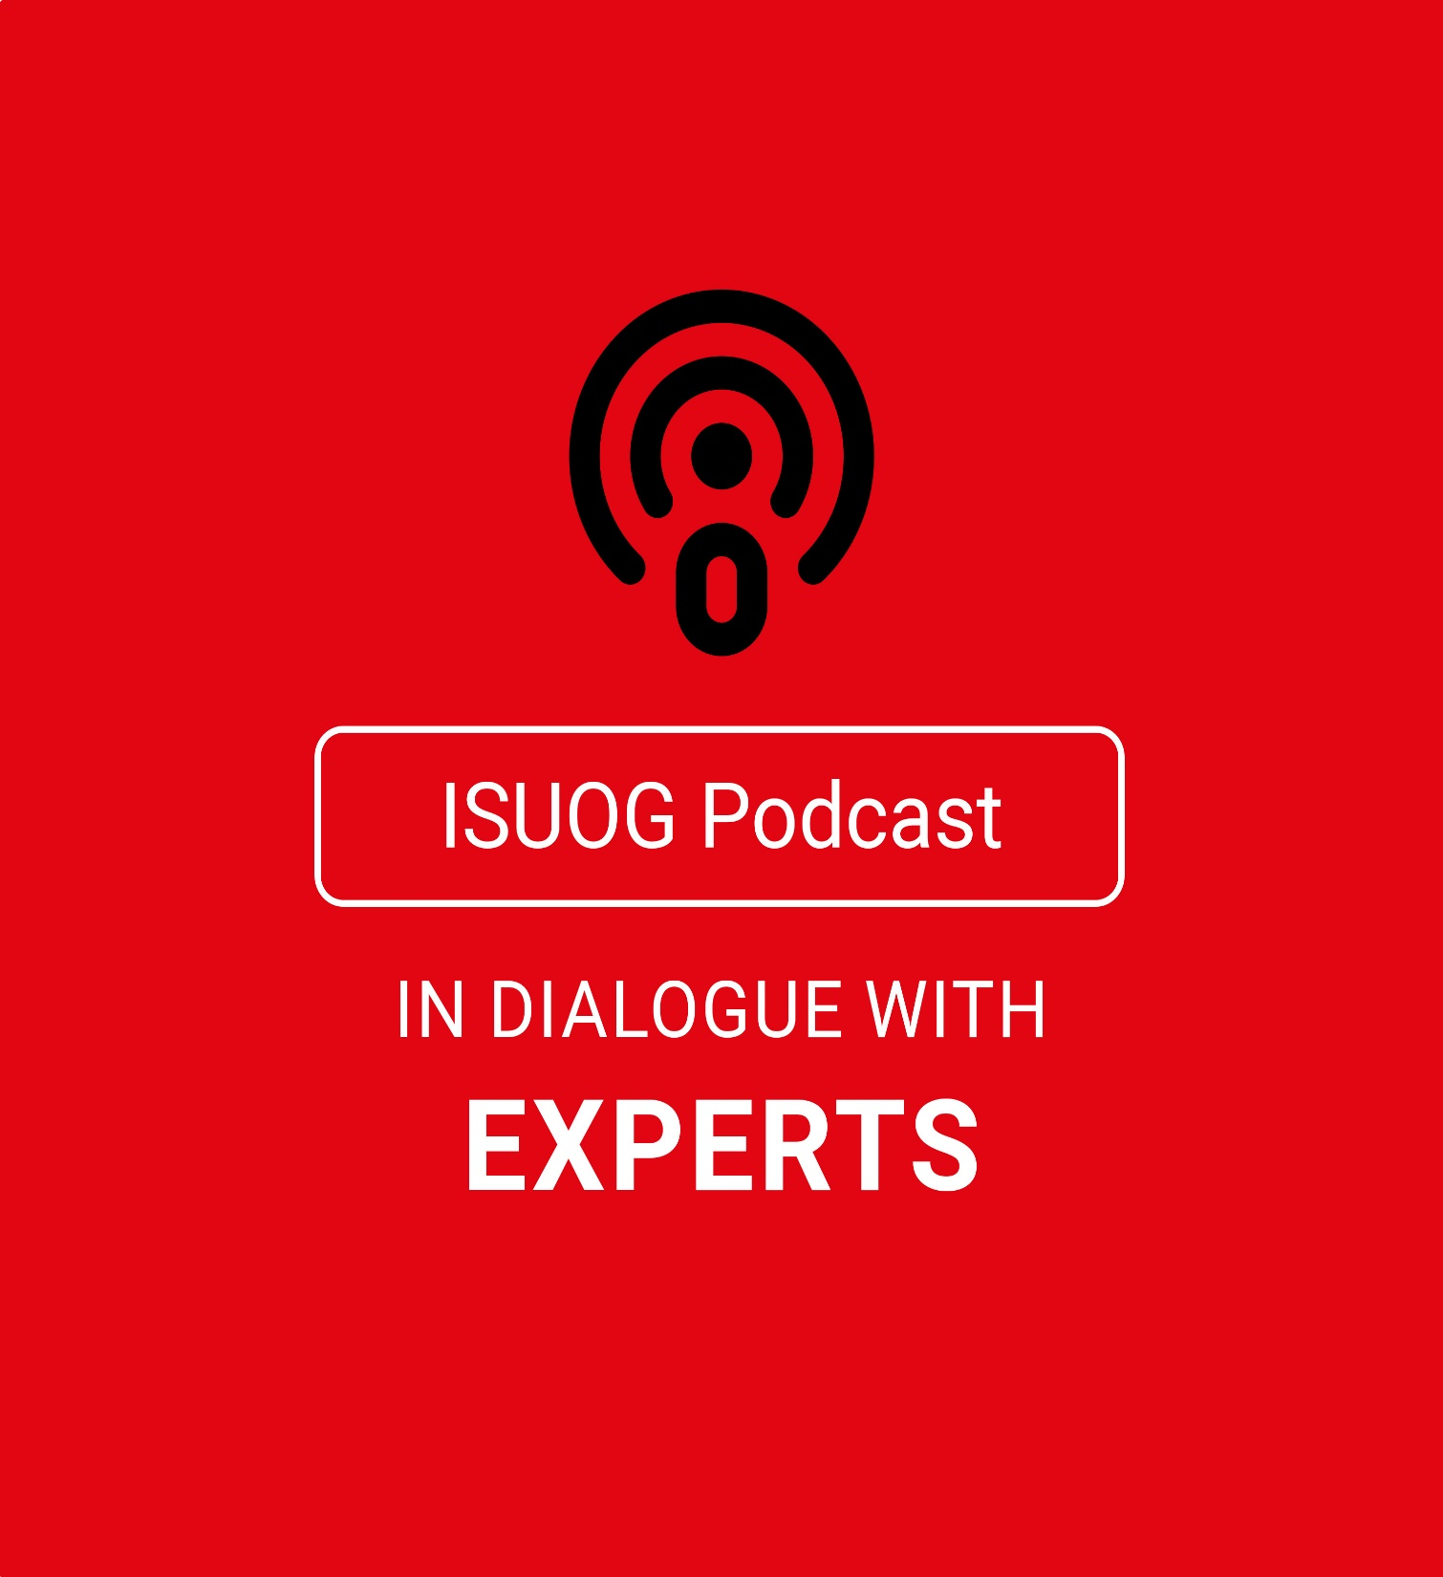

ISUOG Podcast
ISUOG Podcast brings together healthcare professionals for interactive and engaging discussions on various topics in the OBGYN field
and ultrasound. Each episode features experts who share their insights, expertise, and knowledge. They discuss the challenges, limitations, and innovative solutions within the field.
Find us on Spotify or Apple!
Want to feature in an episode? Propose your topic & contact Marcoms@ISUOG.org

Slide 17


→ Raise your professional profile
→ Get published in the UOG Journal
→ Receive discounted registration
→ Apply for a Travel Grant
→ Make a difference in the field of ultrasound in OBGYN
Submit your abstract!
Submission deadline:
18 March 2025

Slide 18





Exclusively for those in lower resource settings inc. South Africa​
Day 1: Gynecology & Early Pregnancy
reproductive health
early pregnancy complications
ultrasound in low-resource settings
IOTA terms and definitions
cervical cancer
Day 2: Obstetrics
management of pre-eclampsia
perinatal genetics
fetal echocardiography & neurosonography
multiple pregnancy
placenta accreta spectrum disorder
REGISTER FOR FREE NOW >

