Slide 1



UOG Journal Club: July 2019
Diagnostic accuracy of saline contrast sonohysterography in detecting endometrial polyps in women with postmenopausal bleeding: a systematic review and meta-analysis
A. J. Vroom, A. Timmermans, M. Y. Bongers, E. van den Heuvel,
P. M. A. J. Geomini and N. van Hanegem
Volume 54, Issue 1, pages 26-32
Journal Club slides prepared by
Dr Erkan Kalafat (UOG Editor for Trainees)

Slide 2


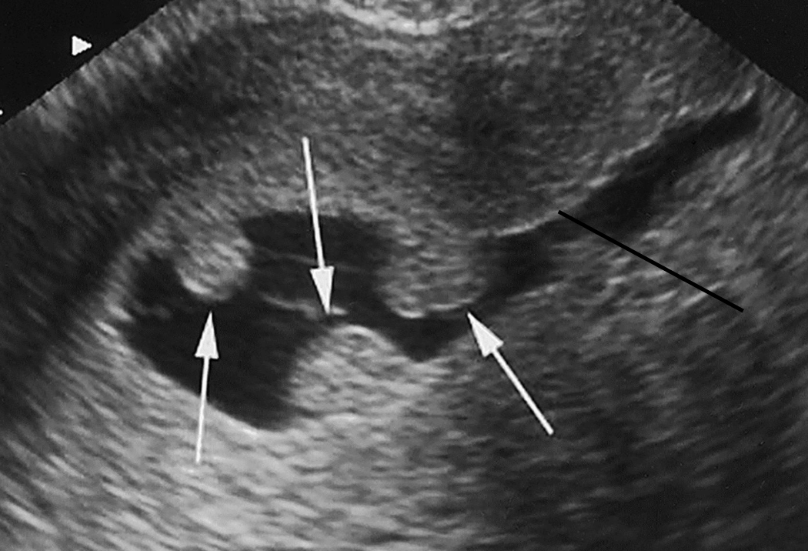
Diagnostic accuracy of saline contrast sonohysterography in detecting endometrial polyps in women with postmenopausal bleeding: systematic review and meta-analysis
Vroom et al., UOG 2019
INTRODUCTION
Approximately, one out of ten women with postmenopausal bleeding (PMB) have underlying endometrial malignancy.
~9%
40% of women with thickened endometrium will have endometrial polyps which carry a 4.47% to 6% risk of focal malignancy.
~5% risk of focal
malignancy
Saline contrast sonohysterography (SCSH) could be used as a method to stratify women with PMB for further treatment.
Image from: Clarke MA, Long BJ, Del Mar Morillo A, Arbyn M, Bakkum-Gamez JN, Wentzensen N. Association of Endometrial Cancer Risk With Postmenopausal Bleeding in Women: A Systematic Review and Meta-analysis. JAMA Intern Med 2018; 178: 1210-1222.

Slide 3
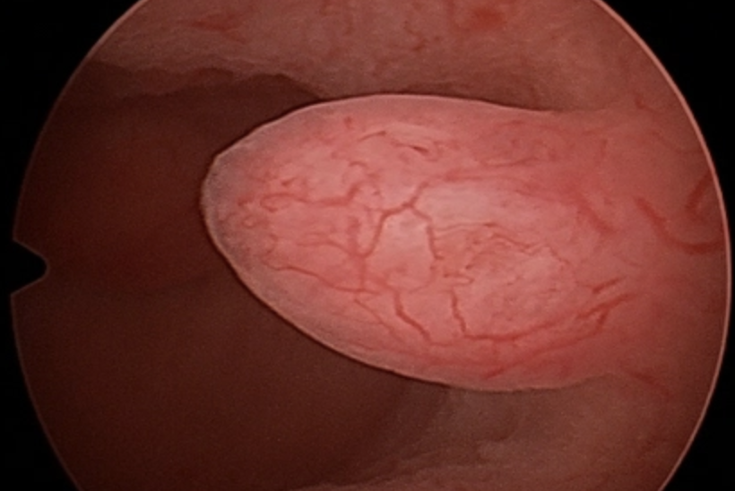

Diagnostic accuracy of saline contrast sonohysterography in detecting endometrial polyps in women with postmenopausal bleeding: systematic review and meta-analysis
Vroom et al., UOG 2019
Hysteroscopy
Saline contrast
sonohysterography (SCSH)
Less invasive and more accessible
86% sensitivity and 81% specificity for detecting polyps in ALL women with bleeding
Only diagnostic
Considered reliable for detecting polyps
Invasive and expensive
Diagnostic and therapeutic

Slide 4
Diagnostic accuracy of saline contrast sonohysterography in detecting endometrial polyps in women with postmenopausal bleeding: systematic review and meta-analysis
Vroom et al., UOG 2019
AIM OF THE STUDY
The aim of this review was to investigate the diagnostic accuracy of SCSH for endometrial polyps in women with PMB, in order to determine whether this minimally invasive method can be used to stratify these women for further diagnostic workup and treatment.

Slide 5
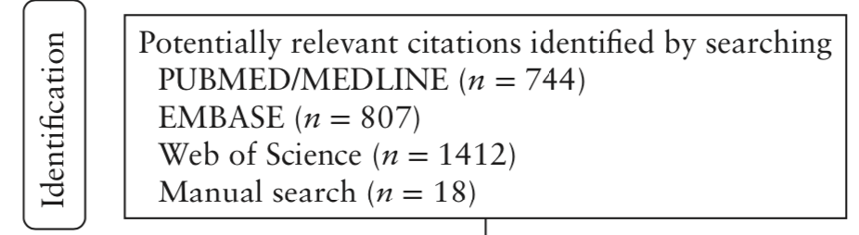
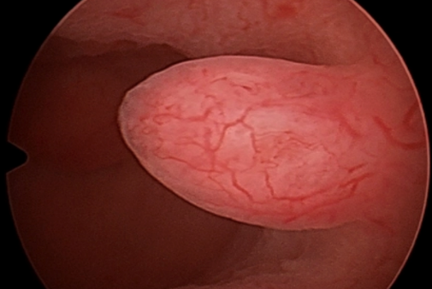
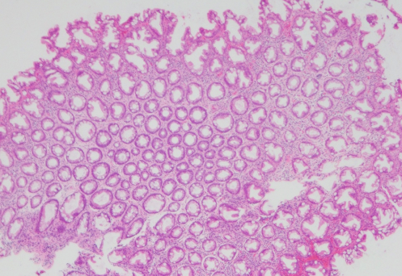
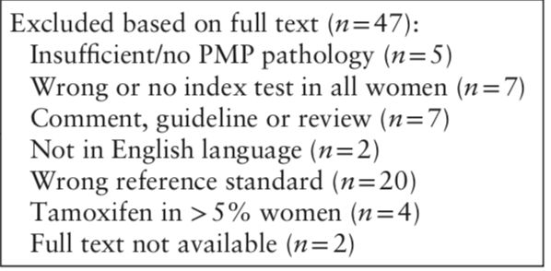
Diagnostic accuracy of saline contrast sonohysterography in detecting endometrial polyps in women with postmenopausal bleeding: systematic review and meta-analysis
Vroom et al., UOG 2019
METHODS
Electronic searches of MEDLINE, EMBASE and Web of Science databases and manual searches were performed on August 2018.
Studies were considered eligible if they compared SCSH with either hysteroscopy or histopathology for detection of endometrial polyps in women with PMB.
Studies using D&C as reference standard and populations with tamoxifen use above 5% were excluded.

Slide 6
Diagnostic accuracy of saline contrast sonohysterography in detecting endometrial polyps in women with postmenopausal bleeding: systematic review and meta-analysis
Vroom et al., UOG 2019
METHODS
After selecting articles eligible for inclusion, the following data were extracted:
  Number of women for whom SCSH and reference test were performed;
  Number of polyps detected, missed or misdiagnosed;
  Number of failed procedures;
  Details oftTamoxifen and hormone replacement therapy use.
Risk of bias in included studies was evaluated using QUADAS-2 tool. Studies with high risk of bias in more than one domain were excluded.
All analyses were performed using SAS with NLMIXED package.

Slide 7
Diagnostic accuracy of saline contrast sonohysterography in detecting endometrial polyps in women with postmenopausal bleeding: systematic review and meta-analysis
Vroom et al., UOG 2019
RESULTS
Six studies were considered initially for inclusion.
However, one study was excluded due to high applicability concerns regarding patient selection and a high risk of bias in patient selection and patient flow.
Therefore, five studies were included in the final analysis.

Slide 8
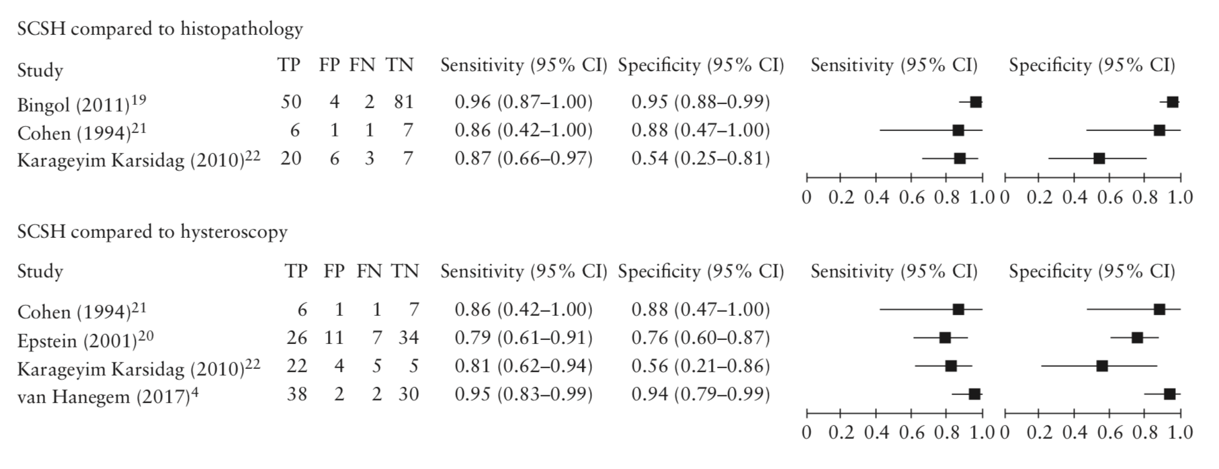
Diagnostic accuracy of saline contrast sonohysterography in detecting endometrial polyps in women with postmenopausal bleeding: systematic review and meta-analysis
Vroom et al., UOG 2019
RESULTS
Using ‘polyps diagnosed with histopathology’ as reference standard, pooled sensitivity was 86.5% (95% CI, 63.6–100%) and pooled specificity was 91.1% (95% CI, 63.2–100%).
Using ‘polyps seen on hysteroscopy’ as reference standard, pooled sensitivity was 85.1% (95% CI, 66.9–100%) and pooled specificity was 84.5% (95% CI, 68.1–100%).

Slide 9
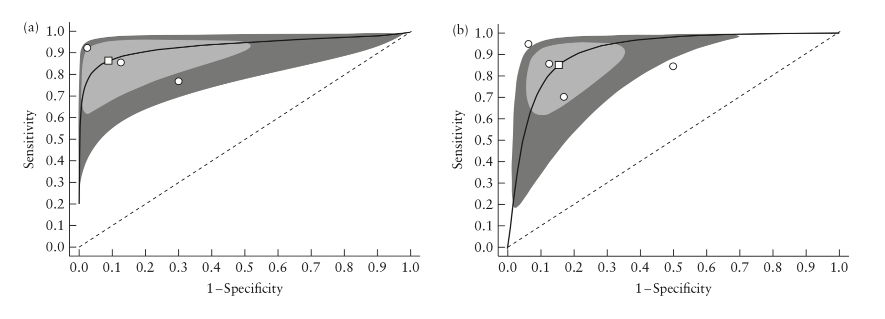
Diagnostic accuracy of saline contrast sonohysterography in detecting endometrial polyps in women with postmenopausal bleeding: systematic review and meta-analysis
Vroom et al., UOG 2019
RESULTS
Hierarchical summary receiver–operating characteristics curves showing diagnostic accuracy of saline contrast sonohysterography for endometrial polyps in women with postmenopausal bleeding using histopathology (a) and hysteroscopy (b) as reference standard.
There was low heterogeneity between studies.
The AUC for SCSH using histopathology as reference standard was 0.934 and the AUC using hysteroscopy as reference standard was 0.913.
These values, in addition to the fact that the SROC curve is close to the top left corner of the graph, indicate that SCSH is a highly accurate diagnostic test.

Slide 10
Diagnostic accuracy of saline contrast sonohysterography in detecting endometrial polyps in women with postmenopausal bleeding: systematic review and meta-analysis
Vroom et al., UOG 2019
DISCUSSION
SCSH can be considered as a method to stratify women with PMB for further diagnostic workup and treatment with hysteroscopy, provided that the examination is of optimal quality.
In women without suspicion of a polypoid lesion on SCSH and with a benign endometrial sample, expectant management should be considered.
The results of this meta-anaylsis do not apply to women with PMB using tamoxifen.

Slide 11
Diagnostic accuracy of saline contrast sonohysterography in detecting endometrial polyps in women with postmenopausal bleeding: systematic review and meta-analysis
Vroom et al., UOG 2019
POINTS FOR DISCUSSION
Reasons for SCSH having superior specificity in women with PMB compared with women of all ages with abnormal uterine bleeding.
Pros and cons of using SCSH as first-line diagnostic test for PMB.
How would you expect the results (sensitivity and specificity) to change if routine transvaginal ultrasonography was compared to histopathology and hysteroscopy in this review ?

