Slide 1
“How To” record uterine artery Doppler at 11–13 weeks
How To: Record uterine artery Doppler pulsatility index (PI) at 11+0 to 13+6 weeks’ gestation
Indication: To screen in the first trimester for pre-eclampsia and/or fetal growth restriction
Machine settings: Routine first-trimester scan preset with color Doppler velocity 30–40 cm/s, pulsed wave Doppler velocity 80–100 cm/s, low filter (50–100 Hz) and pulsed Doppler sample volume 2 mm

Slide 2
Uterine artery Doppler: identifying the cervix
Obtain a mid-sagittal section of the uterus and cervix
Use HD zoom to enlarge the view of the cervix

Slide 3
Uterine artery Doppler: identifying the uterine artery
Apply color flow mapping
Slide the transducer to view the para-cervical region
Gently move the transducer from side to side to identify the uterine artery
The uterine arteries are at the level of the internal cervical os
Mid-sagittal view
Bladder
Cervix
Paramedian view

Slide 4
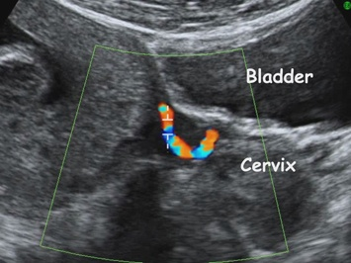
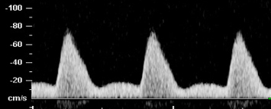
Uterine artery Doppler: obtaining a spectral Doppler signal
Color Doppler of uterine arteries
Set the sampling gate to 2 mm so as to cover whole vessel
Angle of insonation should be less than 30º
The peak systolic velocity should be more than 60 cm/s in the uterine artery
Obtain three similar consecutive waveforms
The mean PI is obtained as the average of the left PI and right PI
Uterine artery waveform

