Slide 1

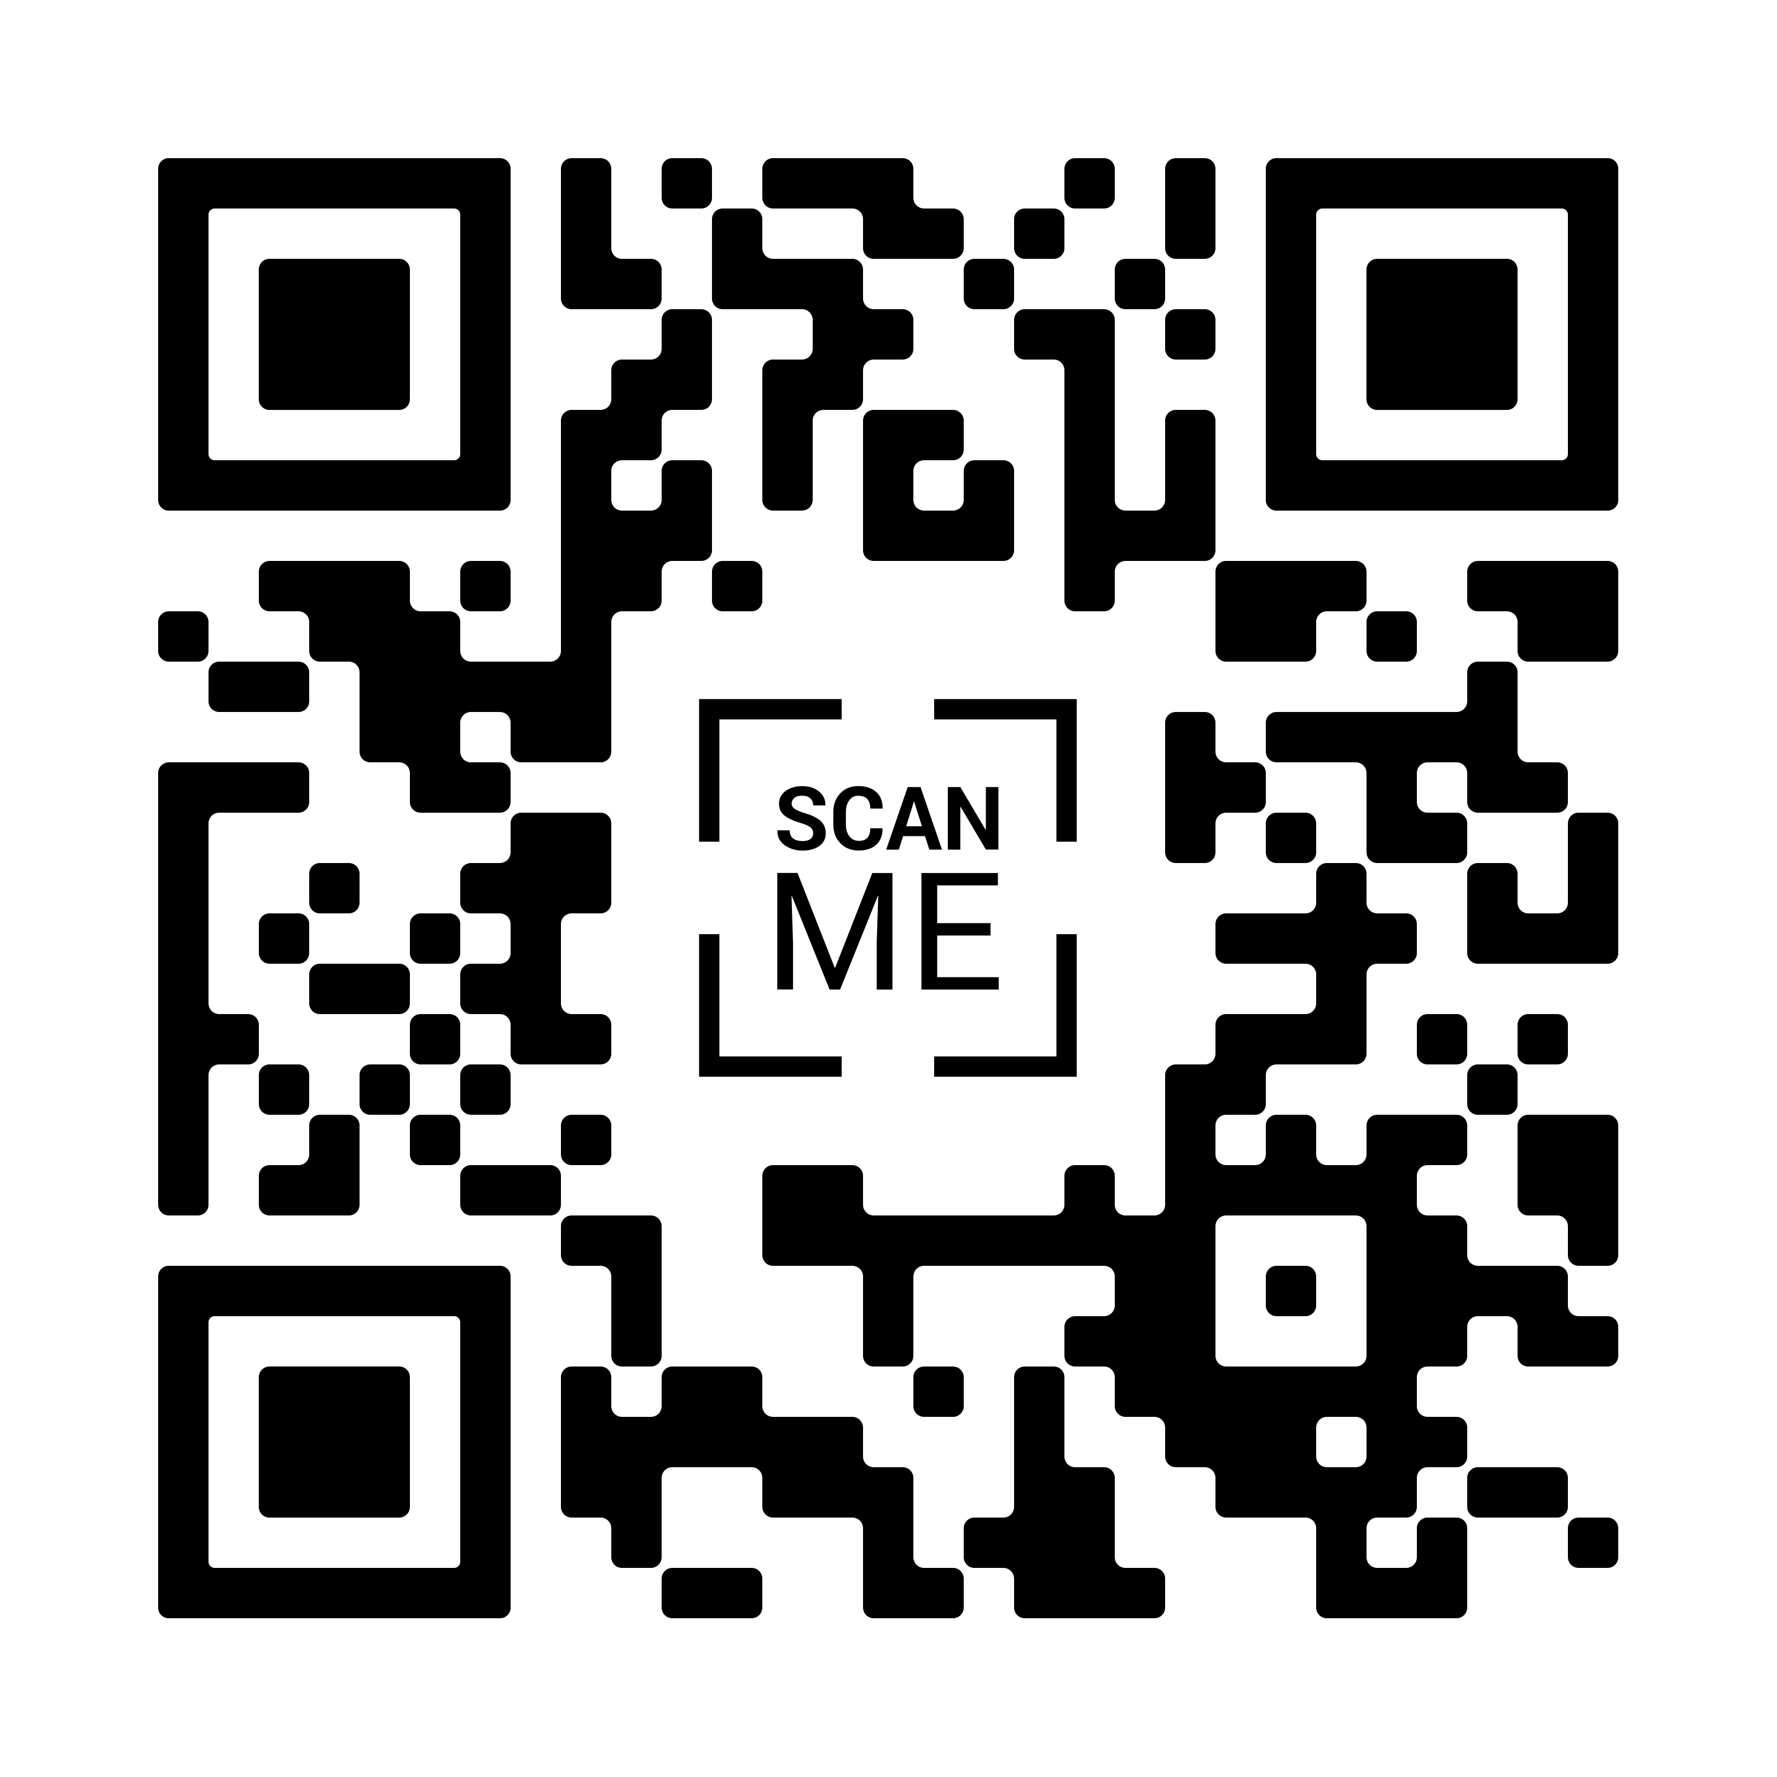
→ Raise your professional profile
→ Get published in the UOG Journal
→ Receive discounted registration
→ Apply for a Travel Grant
→ Make a difference in the field of ultrasound in OBGYN
Submit your abstract!
Submission deadline:
18 March 2025

